Slide 1
ML Model serialization formats
Pravin Y Pawar
Adapted from “Three Levels of ML Software”

Slide 2
Model File Formats
In supervised machine learning, the artefact created after training that is used to make predictions on new data is called a model
For example, after training a deep neural network (DNN), the trained model is basically a file containing the layers and weights in the DNN
Often, models can be saved in a file that can potentially be compressed,
so typically model files have a binary file format
TensorFlow saves models as protocol buffer files, with a .pb file extension
Keras saves models natively as .h5 file
Scikit-Learn saves models as pickled python objects, with a .pkl file extension
An older format for model serving based on XML, predictive model markup language (.pmml)
is still usable on some frameworks, such as Scikit-Learn.

Slide 3
Model files
Used to make predictions on new data by
either batch applications that typically read the model in as a file
or a real-time model serving server (such as TensorFlow Serving Server) that reads the model into memory,
may even have multiple versions of a model in memory for AB testing

Slide 4
ML Model serialization formats
Various formats to distribute ML models
In order to achieve a distributable format, the ML model should be present and should be executable as an independent asset
For example, might want to use a Scikit-learn model in a Spark job - means that the ML models should work outside of the model-training environment
Two broad exchange formats for ML models.
Language-agnostic
Vendor-specific

Slide 5
Language-agnostic exchange formats
Amalgamation and PMML
Amalgamation
simplest way to export an ML model - model and all necessary code to run are bundled as one package
usually, a single source code file that can be compiled on nearly any platform as a standalone program
straightforward concept, and the exported ML models are portable
For example,
can create a standalone version of an ML model by using SKompiler
python package provides a tool for transforming trained Scikit-learn models into other forms,
such as SQL queries, Excel formulas, Portable Format for Analytics (PFA) files, or SymPy expressions
PMML
a format for model serving based on XML with the file extension .pmml
has been standardized by the Data Mining Group (DMG)
Basically, .ppml describes a model and pipeline in XML
does not supports all of the ML algorithms
usage in open source-driven tools is limited due to licensing issues

Slide 6
Language-agnostic exchange formats(2)
PFA
PFA (Portable Format for Analytics)
designed as a replacement for PMML
To run ML models as PFA files, will need a PFA-enabled environment
From DMG:
“A PFA document is a string of JSON-formatted text that describes an executable called a scoring engine. Each engine has a well-defined input, a well-defined output, and functions for combining inputs to construct the output in an expression-centric syntax tree”.
PFA capabilities include
control structures, such as conditionals, loops, and user-defined functions,
expressed within JSON, and can, therefore, be easily generated and manipulated by other programs,
fine-grained function library supporting extensibility callbacks

Slide 7
Language-agnostic exchange formats(3)
ONNX
ONNX (Open Neural Network eXchange)
an ML framework independent file format
was created to allow any ML tool to share a single model format
is supported by many big tech companies such as Microsoft, Facebook, and Amazon
Once the ML model is serialized in the ONNX format,
can be consumed by onnx-enabled runtime libraries (also called inference engines) and then make predictions
most deep learning tools have ONNX support
A game changer for industrialized AI as models can be rendered interoperable and framework-independent

Slide 8
Language-agnostic exchange formats(4)
YAML
YAML is used to package models as part of the MLFlow framework for ML pipelines on Spark
MLFlow stores a YAML file that describes the files it packages for model serving
so that deployment tools can understand the model file format and know what files to deploy

Slide 9
Vendor-specific Exchange formats
Scikit-Learn
saves models as pickled python objects, with a .pkl file extension
H2O
allows to convert the models built to either POJO (Plain Old Java Object) or MOJO (Model Object, Optimized)
SparkML
models can be saved in the MLeap file format and served in real-time using an MLeap model server
supports Spark, Scikit-learn, and Tensorflow for training pipelines and exporting them to an MLeap Bundle
The MLeap runtime is a JAR that can run in any Java application
TensorFlow
saves models as .pb files; which is the protocol buffer files extension
PyTorch
serves models by using their proprietary Torch Script as a .pt file
model format can be served from a C– application

Slide 10
Vendor-specific Exchange formats(2)
Keras
saves a model as a .h5 file, which is known in the scientific community as a data file saved in the Hierarchical Data Format (HDF)
file contains multidimensional arrays of data
Apple
has its proprietary file format with the extension .mlmodel to store models embedded in iOS applications
The Core ML framework has native support for Objective-C and Swift programming languages
Applications trained in other ML frameworks, such as TensorFlow, Scikit-Learn, and other frameworks need to use tools like such as coremltools and Tensorflow converter to translate their ML model files to the .mlmodel format for use on iOS

Slide 11
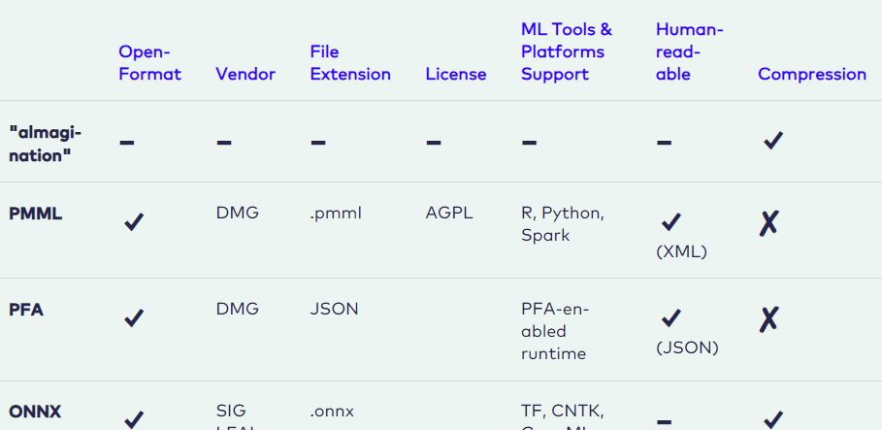
Summarizes of all ML model serialization formats

Slide 12
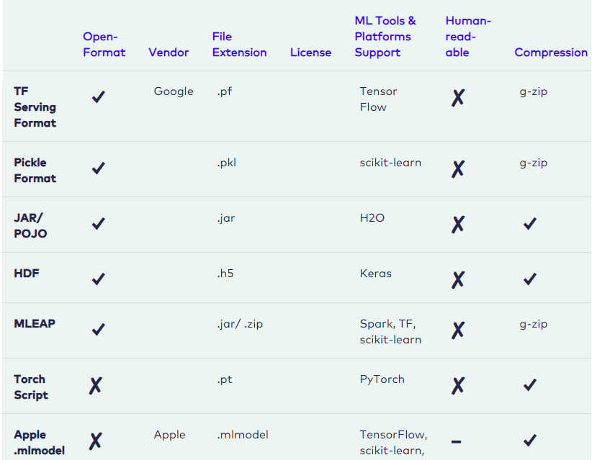
Summarizes of all ML model serialization formats(2)

Slide 13
Thank You!
In our next session:

